Slide 1
Assets Under Management
Asset Class (AUM R’bn)
Client Type
Source: Prescient Investment Management (31 January 2026)
Source: Prescient Investment Management (31 January 2026)
Notes:
Highlight asset diversity across capabilities and products.
Traditionally known as fixed interest manager.
Ambitious growth aspirations in the equity, multi-asset and global space as we believe we have an edge there through the skillful application of our 3 core skills of asset allocation, yield generation and risk/derivative management
Approximately even split between Institutional and Retail investors – client base well diversified.

Slide 2
Prescient investment management
Assets under management
Source: Prescient Investment Management (as at 31 January 2026)

Slide 3
Prescient investment management
Investment team organogram
Cheree Dyers
Chief Executive Officer
Bastian Teichgreeber
Chief Investment Officer
Odwa Sihlobo
Head of Research
Cash & Income
Bonds
Credit
Multi-Asset
Equities
Data Science
Portfolio Risk and Analytics
Henk Kotze
Head of Cash & Income
Reza Ismail
Head of Bonds
Conway Williams
Head of Credit
Rupert Hare
Head of Multi-Asset
Seeiso Matlanyane
Head of Equities
Tim Terblanche
Head of Data Science
Ruan Yacumakis
Manager: Portfolio Risk and Analytics
Jabulani Ngobese
Portfolio Manager
Vishal Rama
Quantitative Analyst
Luzuko Nomjana
Portfolio Manager
Martin Hammond
Portfolio Manager
Romelon Chetty
Portfolio Manager
Chloe Townsend
Data Scientist
Keasha Richards
Risk and Performance Analyst
Michele van der Berg
Portfolio Manager
Isabella Turro
Quantitative Analyst
Michelle Green
Credit Analyst
Nabeel Kolia
Portfolio Manager
Ashleigh Allan
Dealer
New Joiner
Data Scientist
Ishma-eel Allie
Portfolio Manager
Sajjaad Ahmed
Portfolio Manager
Shriya Roy
Portfolio Manager
Dimpho Sekhaolelo
Quantitative Analyst
Chanté Burger
Portfolio Manager
Adelay Pretorius
Graduate Programme
Noeriniche Appels
Quantitative Analyst
Nicholas de Clercq
Quantitative Analyst
Noxolo Sicuku
Implementation Specialist & Quantitative Analyst
Kelly Vlug
Quantitative Analyst
Michael Temple
Quantitative Analyst
Kelli Frew
Quantitative Analyst
Snothando Ntshembeni
Quantitative Analyst
Lauren Naidoo
Implementation Specialist & Quantitative Analyst

Slide 4





Equity Team
 | Seeiso Matlanyane | Romelon Chetty | Ashleigh Allan | Dimpho Sekhaolelo | Nicholas de Clercq*
Qualification | BBusSc Economics, FRM, CAIA, CFA | BBusSc Analytics, FRM | BCom Investment Management, BCom (Hons) Financial Planning, Adv Dip Financial Markets, Adv Cert in Management Practice | BSc Mathematical Statistics, MBA | BCom (Hons) Actuarial Science, CQF
Industry | 11 | 7 | 16 | 5 | 4
Title | Head of Equities | Portfolio Manager | Trader | Quantitative Analyst | Quantitative Analyst
* FAIS Representative under supervision

Slide 5
propositions
Prescient Core Equity Fund Strategies
 | Prescient Core Equity Fund (multiple indices)
Inception dates | Equity QuantPlus Composite (April 2002) Enhanced SWIX Composite (September 2014) Core All Share Composite (January 2020) General Equity Composite (January 2023)
Benchmark | FTSE/JSE All Share FTSE/JSE SWIX FTSE/JSE Capped SWIX FTSE/JSE Top40 (ASISA) General Equity Category Average
Opportunity set | Listed equities, Price futures, Total return futures, Total return swaps
Risk tolerance | High
Information ratio | ~1.0
Regulation Compliance | CISCA and Reg 28
The Core Equity strategy offers a suite of funds which follow an Enhanced Indexation investment process designed to closely track the performance of the benchmark index while systematically generating modest but consistent outperformance to offset the cost of implementation and generate above benchmark performance, after fees.
Prescient employs quantitative indexation techniques to replicate the constituents and performance of a target benchmark index whilst applying low risk return enhancement strategies to generate small, yet reliable alpha over the benchmark
The General Equity strategy has been created as a solution for investors seeking consistent, above average returns relative to the general equity market. The Strategy is also an ideal building block for peer cognisant balanced funds.
The Strategy is designed to systematically determine the average exposures of all the funds within the South African General Equity category using robust quantitative methods before actively employing an enhanced indexation process to deliver superior risk adjusted returns.

Slide 6
proposition
Prescient Core Global Equity Fund
 | Prescient Core Global Equity Fund
Inception dates | Core Global Equity MSCI Composite (June 2021) Core Global Equity MSCI EM Composite (September 2022)
Benchmark | MSCI World MSCI EM
Opportunity set | Price futures, Total return swaps
Risk tolerance | High
Information ratio | ~1.0
Regulation Compliance | CISCA (feeder) and UCITS
The Prescient Core Global Equity Fund Strategy offers a suite of funds which follow an Enhanced Indexation investment process designed to closely track the performance of the benchmark index while systematically generating modest but consistent outperformance to offset the cost of implementation and generate above benchmark performance, after fees. To achieve this, Prescient employs quantitative indexation techniques to replicate the constituents and performance of a target benchmark index whilst applying low risk return enhancement strategies to generate small yet reliable alpha over the benchmark.

Slide 7
Current equity aum
ZAR 23.4 bn as of 31 January 2026
Source: Prescient as of 31 January 2026

Slide 8
Equity propositions
AUM growth
Source: Prescient as of 31 January 2026

Slide 9

INVESTMENT PHILOSOPHY AND PROCESS

Slide 10
Investment Philosophy
Rational
Rules and evidence based
Data driven
Unbiased decisions
Clear strategies and processes
Consistent long-term outperformance

Slide 11
Prescient Core Equity Strategy
The best of both worlds
Active
Prescient Core Equity Process
Passive
Positive Outperformance Target
Active Allocation of Capital
Higher Tracking Error
Higher Turnover
Higher Costs
Lower Tracking Error
Lower Turnover
Lower Costs
Passive Allocation of Capital
Designed to Underperform

Slide 12
Portable alpha
Physical Holdings
Market Returns
=
Option 1: Outright purchase – the same as pure passive physical replication

Slide 13
Portable alpha
Physical Holdings
Market Returns
=
Cash
Market Exposure
Market Returns
+
=
Option 2: Unfunded purchase – gives the same exposure as when cost of funding exactly offsets cash yield

Slide 14
Portable alpha
Option 2 gives opportunity to generate excess return
Physical Holdings
Market Returns
=
Cash
Market Exposure
Market Returns
+
=
Cash + α
Market Exposure
Market Returns + α
+
=

Slide 15
Portable alpha
Enhanced indexation process
Excess Cash and Money Market return is obtained from Term (duration) and/or Credit
In order to generate alpha, the cash and money market assets must be invested in assets that:
Offer a higher fixed rate of return because capital is tied up for a longer period of time, i.e. term assets
Offer a higher rate of return because the issuer has given probability of defaulting, i.e. credit assets
This is done within the regulation and investment risk tolerances

Slide 16
Portable alpha
Enhanced indexation process

Slide 17
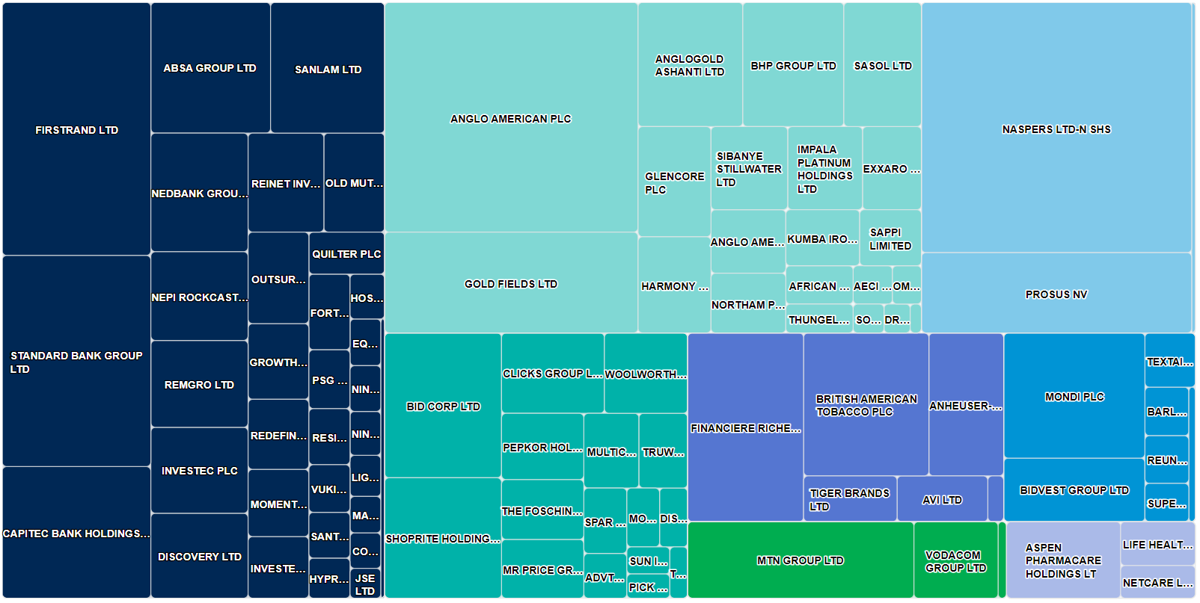
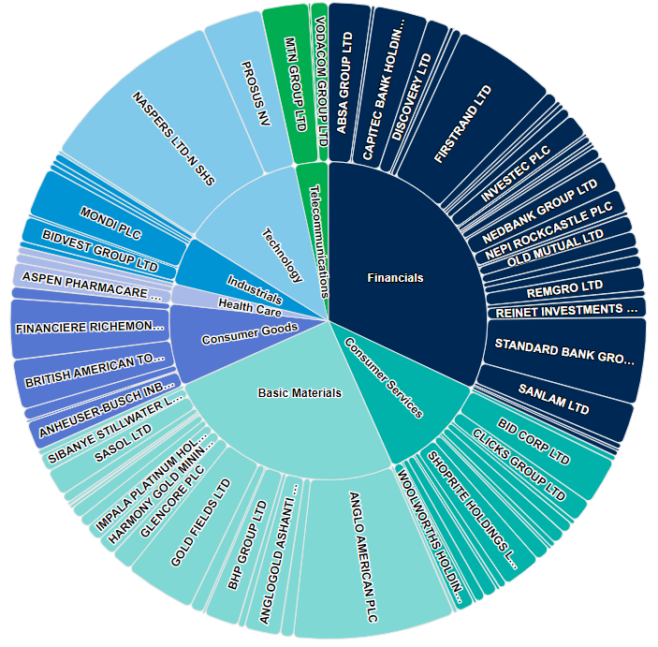
What does the Investor get?
1. Passive Equity Market Beta

Slide 18
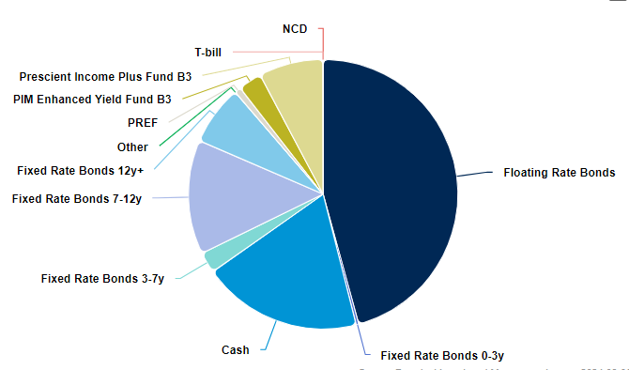
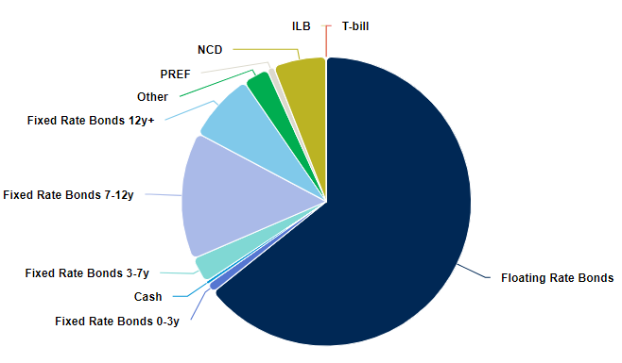
What does the Investor Get?
2. Active Cash and Money Market Alpha

Slide 19
How do we use this to build a portfolio?
Portfolio Construction
R100
Investment
R100
Equity Exposure
R10
Deposits
R30
Credits Assets
Portfolio Value
Active Cash/Money Market Exposure(α)
R60 Term Assets
Passive Equity Market Exposure(β)

Slide 20
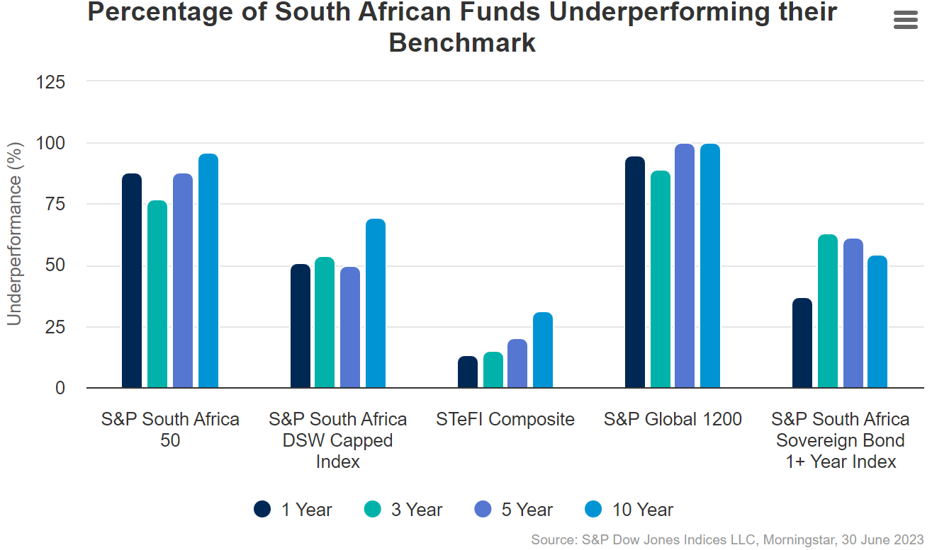
Why is this better than the Pure passive and active?
Efficient Capital Allocation

Slide 21
Equity Market Process and portfolio Construction
CAPPED ALSI

Slide 22
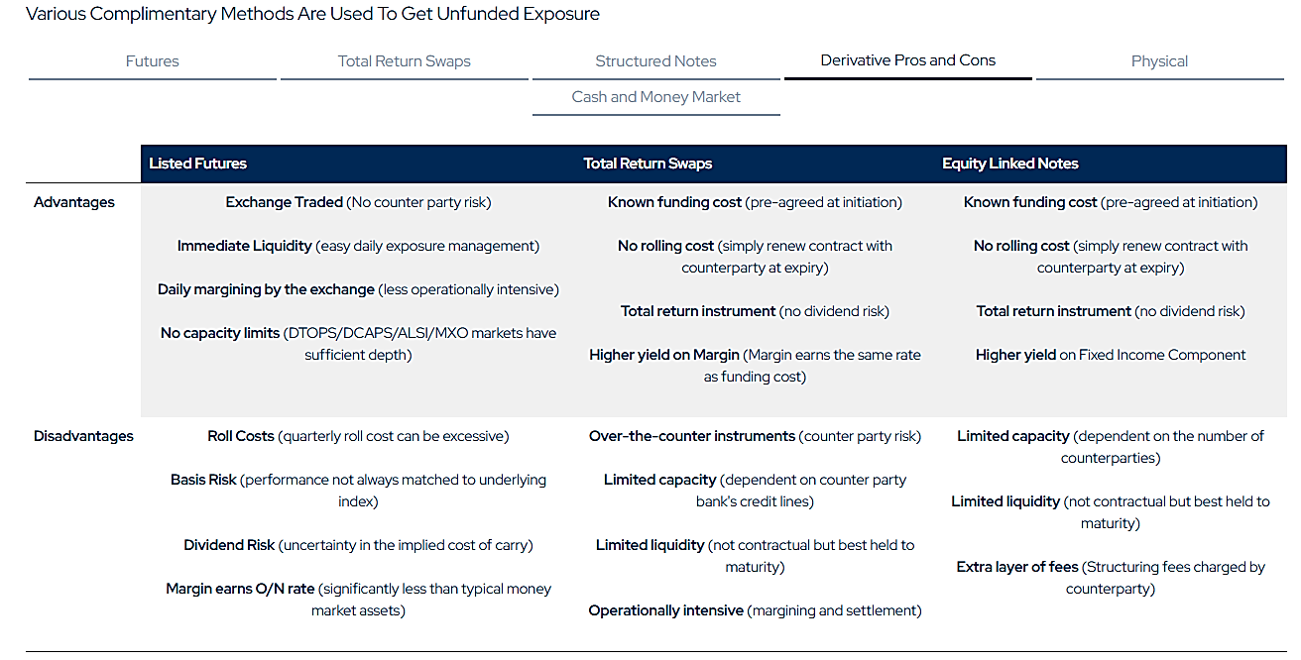
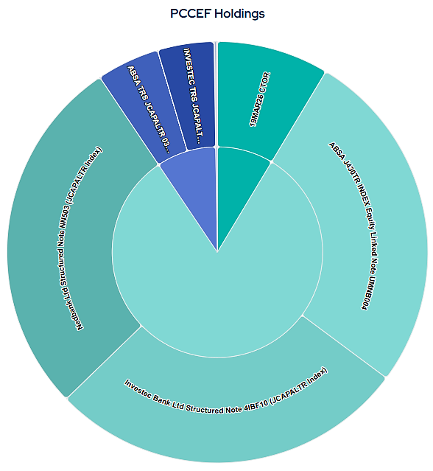
How do we Replicate the Benchmark index?
Equity market exposure
Most of the effective equity exposure through Equity Linked Notes

Slide 23
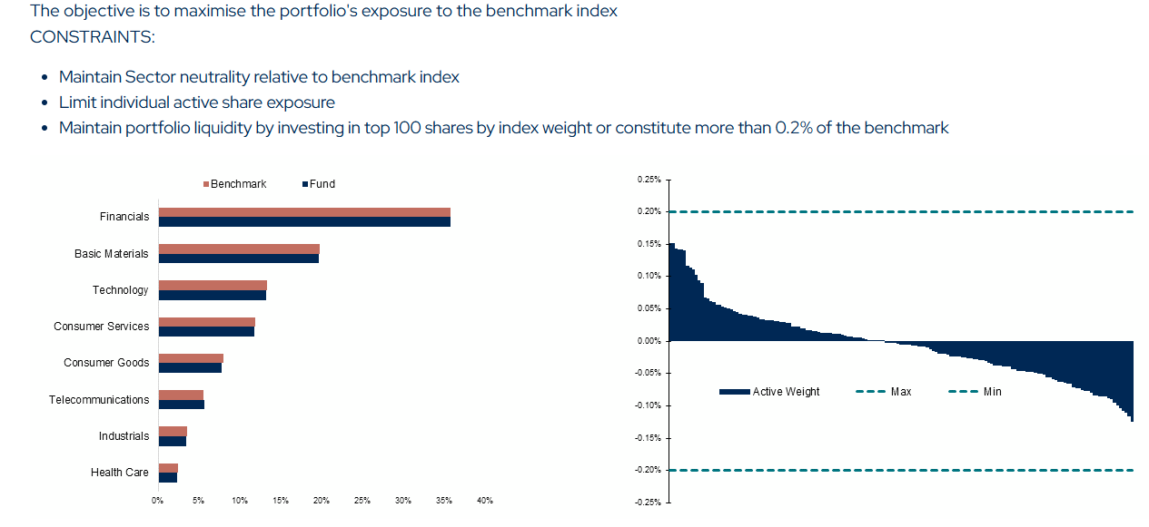
How do we Replicate the Benchmark index?
Equity market exposure
Any physical stock held is optimised for sector and share neutrality

Slide 24
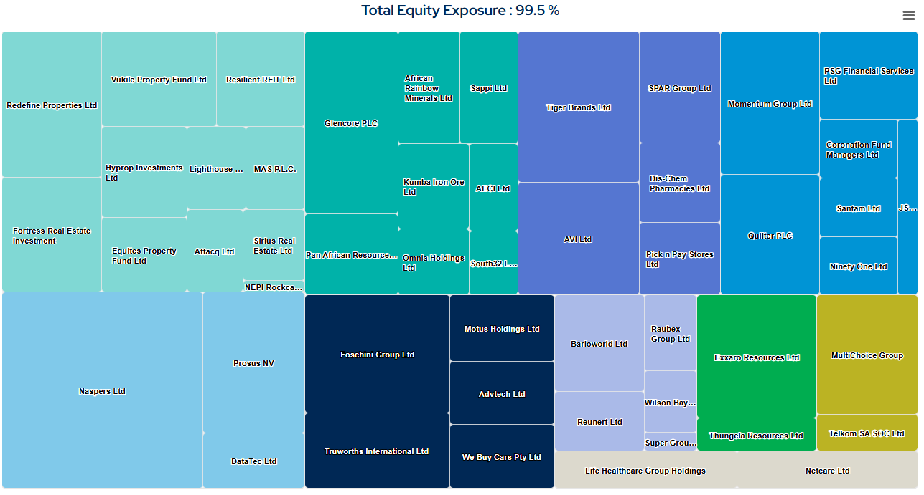
How do we Replicate the Benchmark index?
Equity market exposure
Resulting in the effective equity exposure of the target benchmark index

Slide 25
Equity Market Beta –
Peer cognisant model
GENERAL EQUITY CATEGORY

Slide 26
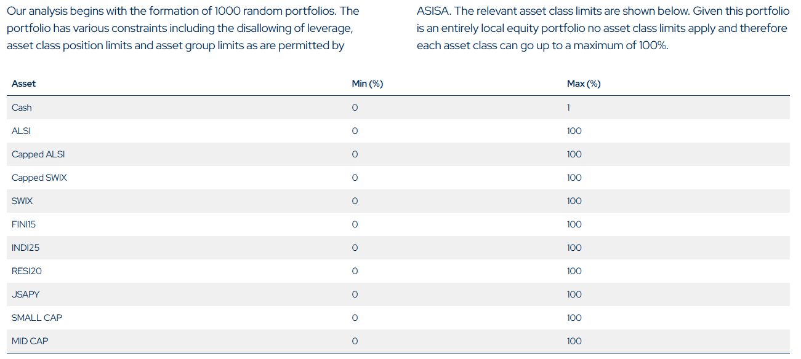
How do we determine the optimal Equity allocation?
Peer Cognisant Model

Slide 27
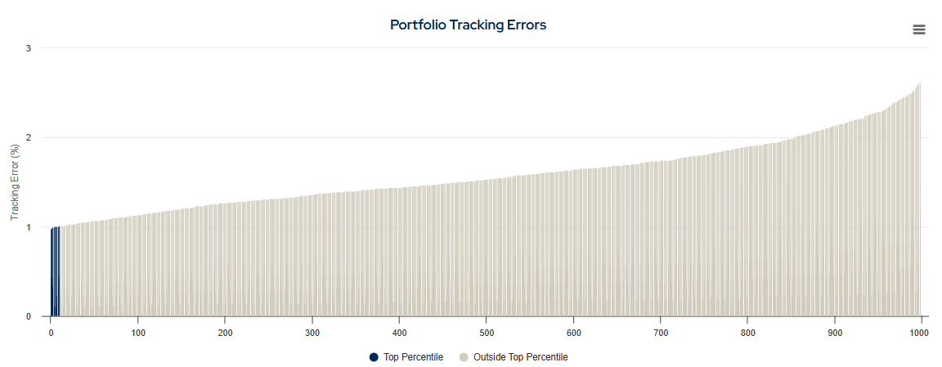
How do we determine the optimal Equity allocation?
Peer Cognisant Model
We measure and select only those portfolio within the lowest 1% tracking error

Slide 28
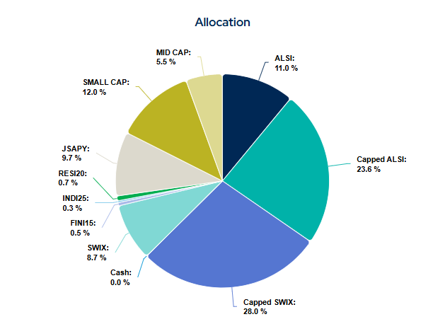
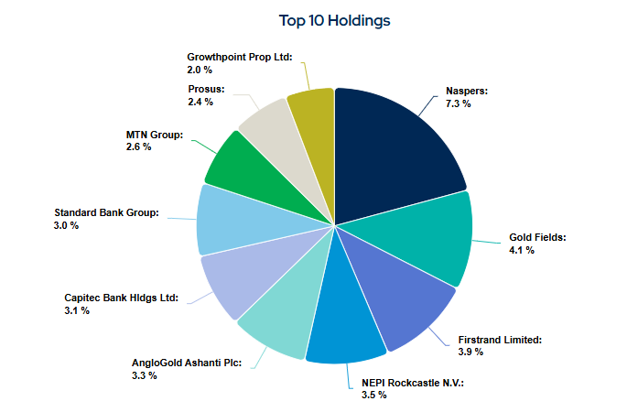
How do we determine the optimal Equity allocation?
Peer Cognisant Model
We calculate the average allocation and share look-through exposure

Slide 29
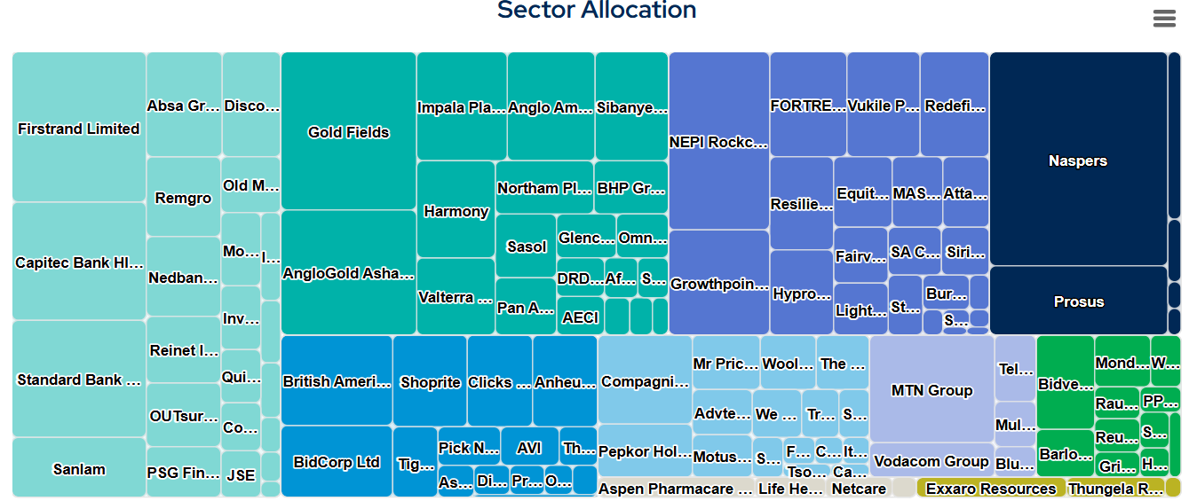
How do we determine the optimal Equity allocation?
Peer Cognisant Model
The resulting allocation is then the dynamic equity beta target

Slide 30
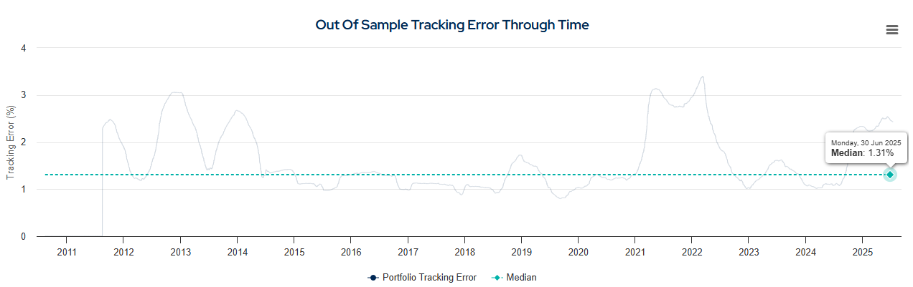
How do we know this Equity allocation works?
Peer Cognisant Model

Slide 31
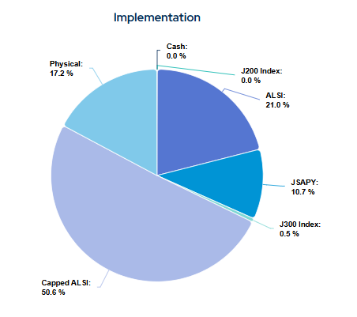
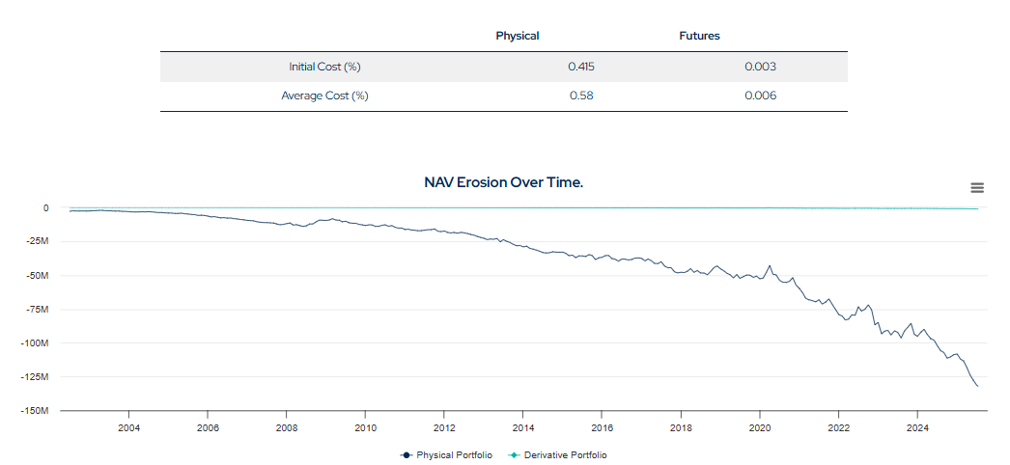
How do we implement this model?
Portfolio Construction
Solve for lowest physical equity portfolio to enable maximum portable alpha

Slide 32
Cash and money market process
Optimisation and Risk Management

Slide 33
how we actively manage the cash and Money Market assets
Enhanced indexation process
Excess Cash and Money Market return is obtained from Term (duration) and/or Credit
In order to generate alpha, the cash and money market assets must be invested in assets that:
Offer a higher fixed rate of return because capital is tied up for a longer period of time, i.e. term assets
Offer a higher rate of return because the issuer has given probability of defaulting, i.e. credit assets
This is done within the regulation and investment risk tolerances

Slide 34
Performance track record

Slide 35
Prescient core capped equity fund
Institutional performance - Prescient Core Capped SWIX Equity Composite

Slide 36
Prescient core capped swix equity composite
Performance
Gross returns to 31 January 2026. Since inception January 2018.

Slide 37
Prescient Core capped swix equity composite
Cumulative Returns
Gross returns to 31 January 2026. Since inception January 2018.

Slide 38
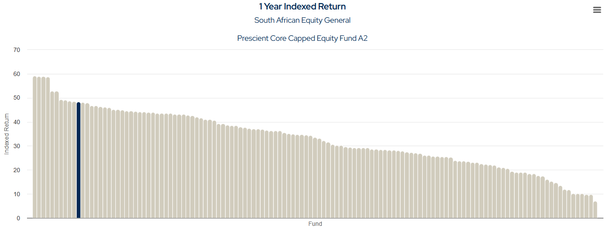
Prescient Core capped equity fund a2
Indexed Return
Source: Prescient Prime Portal, 31 January 2026

Slide 39
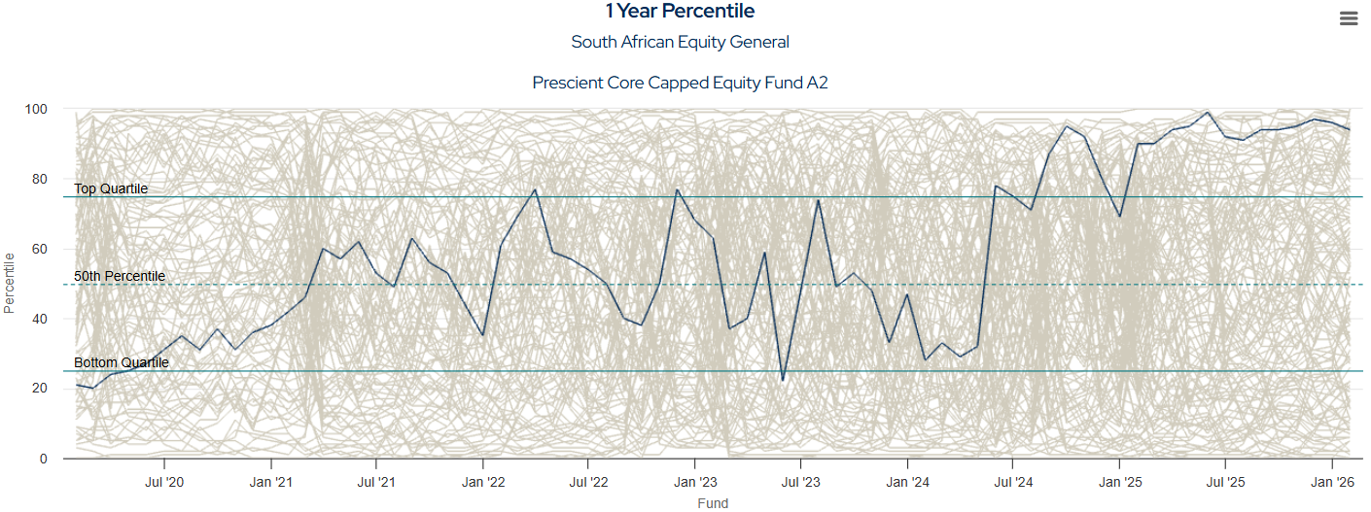
Prescient Core capped equity fund a2
Rolling 1 Year Volatility Percentile Rank
Source: Prescient Prime Portal, 31 January 2026

Slide 40
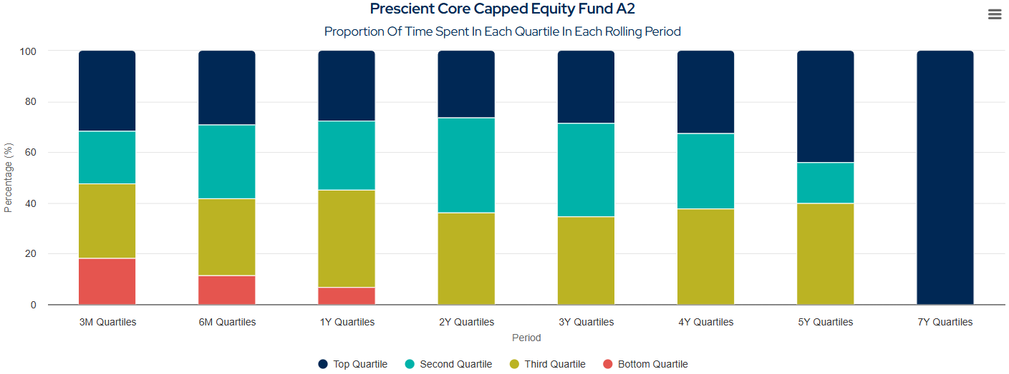
Prescient Core capped equity fund a2
Quartile Analysis
Source: Prescient Prime Portal, 31 January 2026

Slide 41
Prescient core equity
Institutional performance - Prescient Core Equity Composite

Slide 42
Prescient Core Equity SWIX Composite
Performance
Source: Gross returns to 31 January 2026. Since inception September 2014.

Slide 43
Prescient Core Equity SWIX Composite
Cumulative Returns
“Consistency over magnitude”
Source: Gross returns to 31 January 2026. Since inception September 2014.

Slide 44
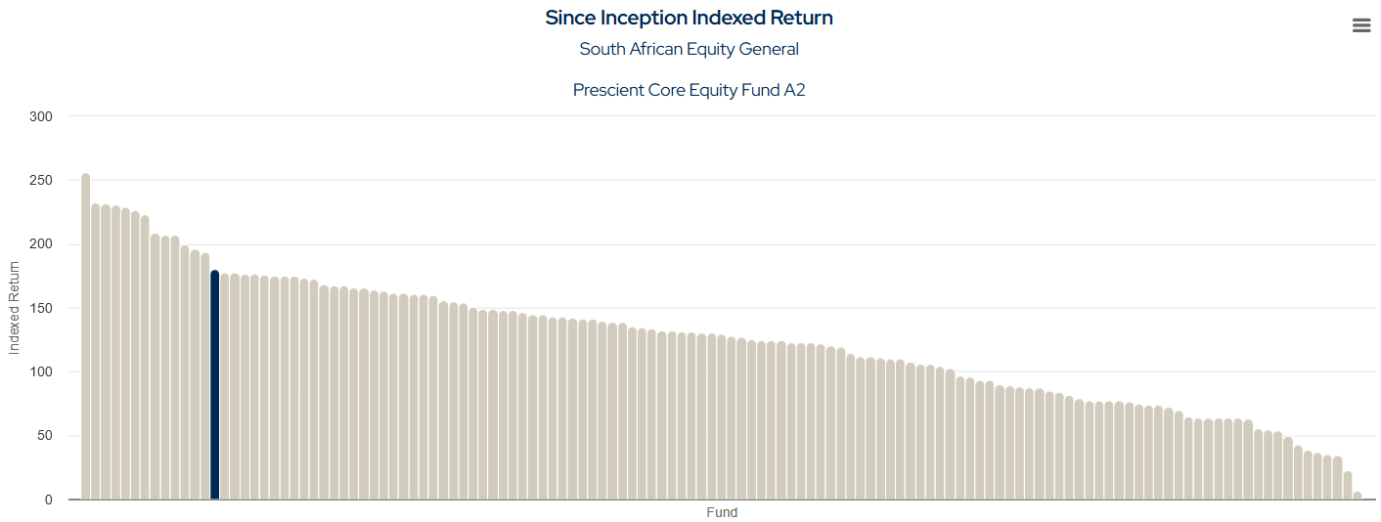
Prescient Core equity fund a2 vs sa equity
Indexed returns
Source: Prescient Prime Portal, 31 January 2026

Slide 45
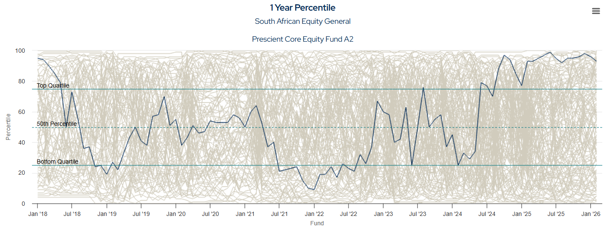
Prescient Core Equity fund a2 vs sa equity
Rolling 1 Year Volatility Percentile Rank
Source: Prescient Prime Portal, 31 January 2026

Slide 46
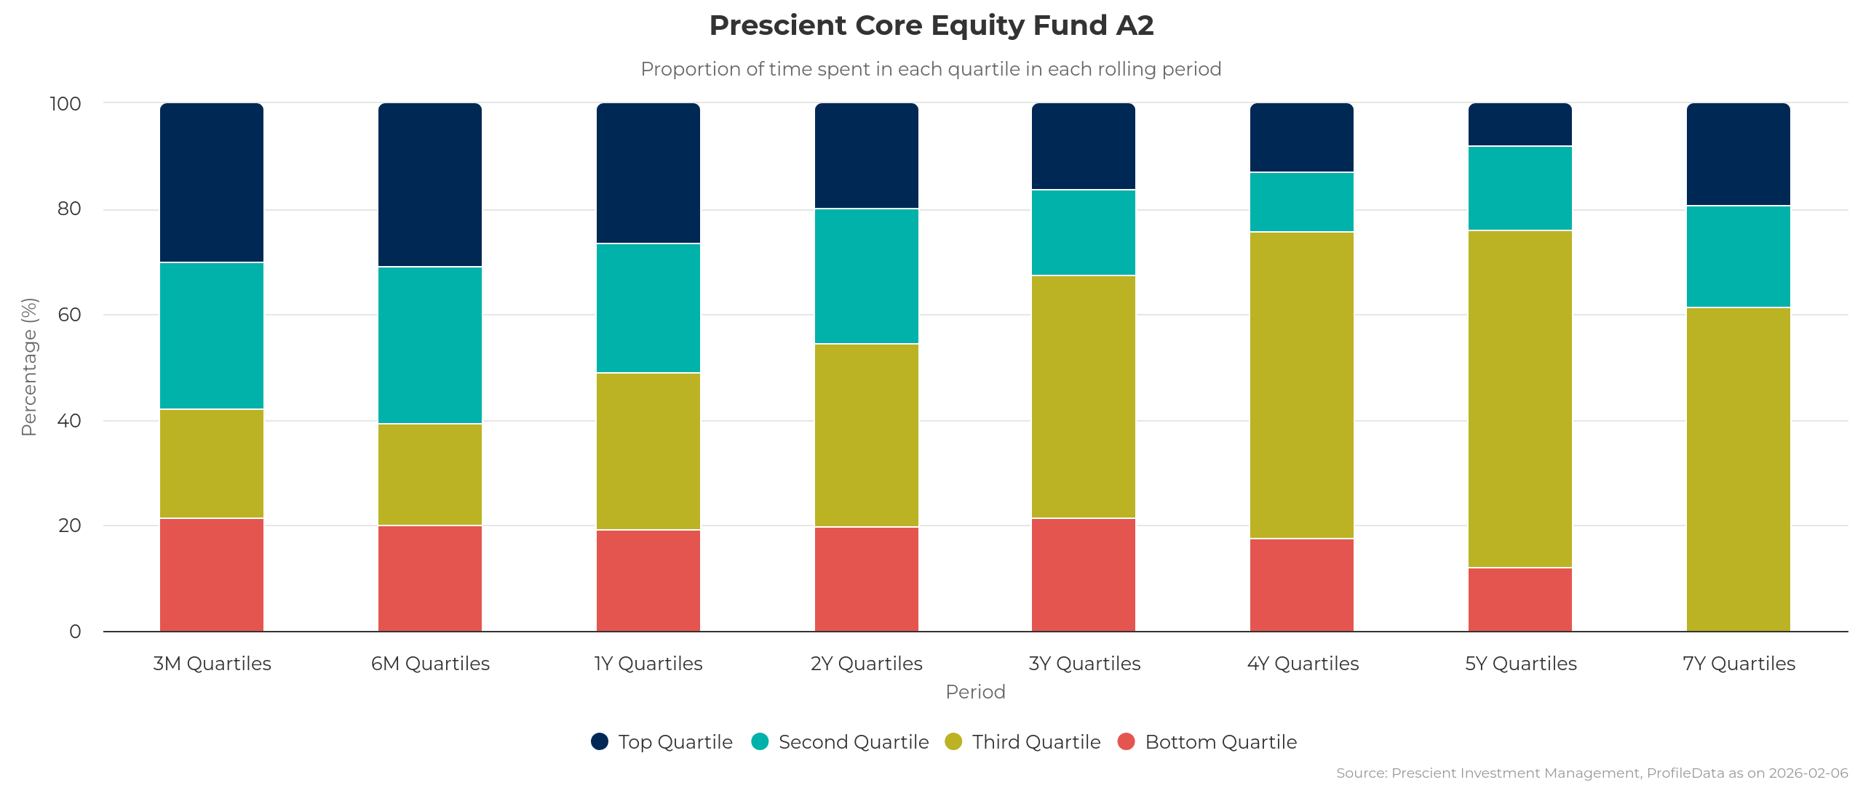
Prescient Core Equity fund a2
Quartile Analysis
Source: Prescient Prime Portal, 31 January 2026

